Slide 1
May 2016
With Christ in our hearts, together we grow

Slide 2
Welcome to our ‘Values’ assembly
A value is a principle that guides behaviour
Week 3

Slide 3
Values that have been discussed so far:
Peace
Courage
Hope
Equality
Compassion
Love
Trust
Respect

Slide 4
In May we will be exploring:
Self-Belief

Slide 5
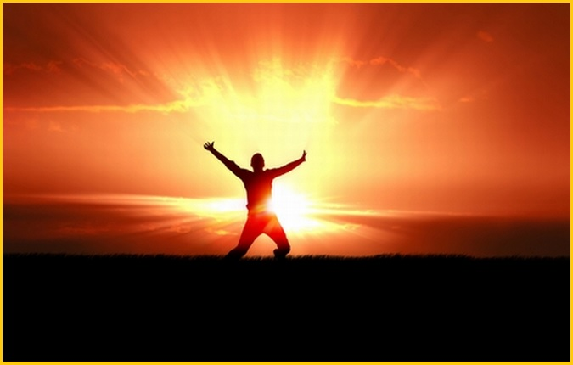

Slide 6
Prayer
Dear God, I am thankful that my life has purpose and meaning. You have made me unique and special. There is nobody on earth exactly like me.
Thank you for seeing the good in me. Help me to become everything you want me to become. God, I am created in your image. Help me to be happy with the way I am made and appreciate the unique qualities and gifts you have given me.
Amen

Slide 7
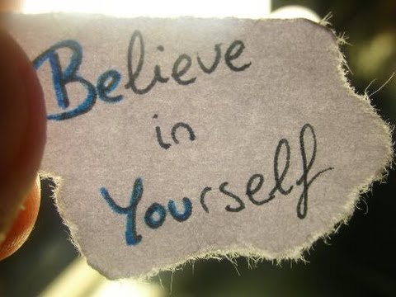

Slide 8
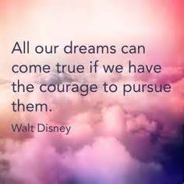

Slide 9
