Slide 1
Parent information meeting January 2017
Handwriting

Slide 2
How do children develop their handwriting skills
In order for children to be able to write words, sentences and long stories they need to have developed all their motor skills first.

Slide 3
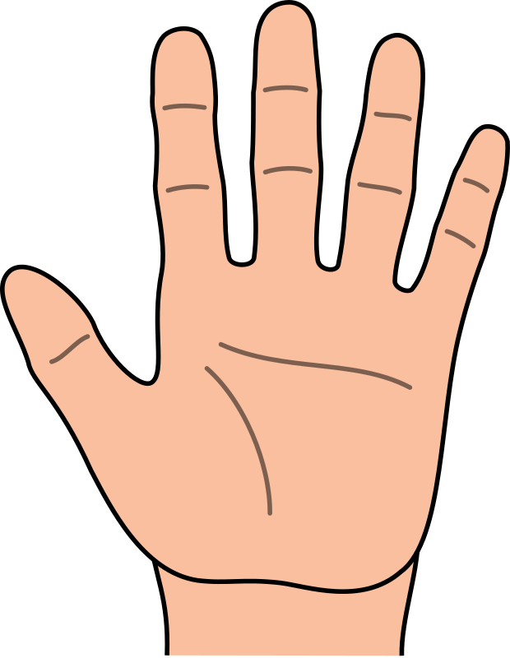
Fine and gross motor skills
Motor skills are actions that involve the movement of muscles in the body. They are divided into two groups:
gross motor skills , which include the larger movements of arms, legs, feet, or the entire body (crawling , running, and jumping);
fine motor skills, which are smaller actions, such as grasping an object between the thumb and a finger or using the lips and tongue to taste objects.
Both types of motor skills usually develop together, because many activities depend on the coordination of gross and fine motor skills.

Slide 4
Gross motor development
Children will all go through the following stages of development, but at different times in their early years life.
With regard to handwriting, the first stage is for the children to use their whole arm to draw their pictures, creating large shapes and lines all over their paper.
The next stage is that they are able to reduce the size of these shapes by only moving the arm from the elbow
Finally they use the small movements in the wrist to control the pen and thus gain more control over their mark making.

Slide 5
Activities to aid gross motor control
Provide large pieces of paper for drawing on
Use paint brushes and water to paint outside- the playground then becomes a big piece of paper.
Allow children to use chalks outside- the rain will wash away any creations ready for the children to draw again the next day!

Slide 6
As young children’s gross motor skills, hand strength and dexterity (fine motor skills) are developing they need a range of pencil, crayon and paint brush thickness. Young children tend to prefer the thicker drawing tools as they can grip them more easily, helping them to mark make. If the pencil is too thin they find it difficult to grasp and control, making the drawing experience unsuccessful, which can lead to frustration and discourage them from trying again.
Vertical drawing and painting surfaces are important in helping young children to develop the wrist strength and flexibility they will need later on to hold a pencil correctly for handwriting. Using plain rather than lined paper is considered best as many children find it less restrictive.

Slide 7
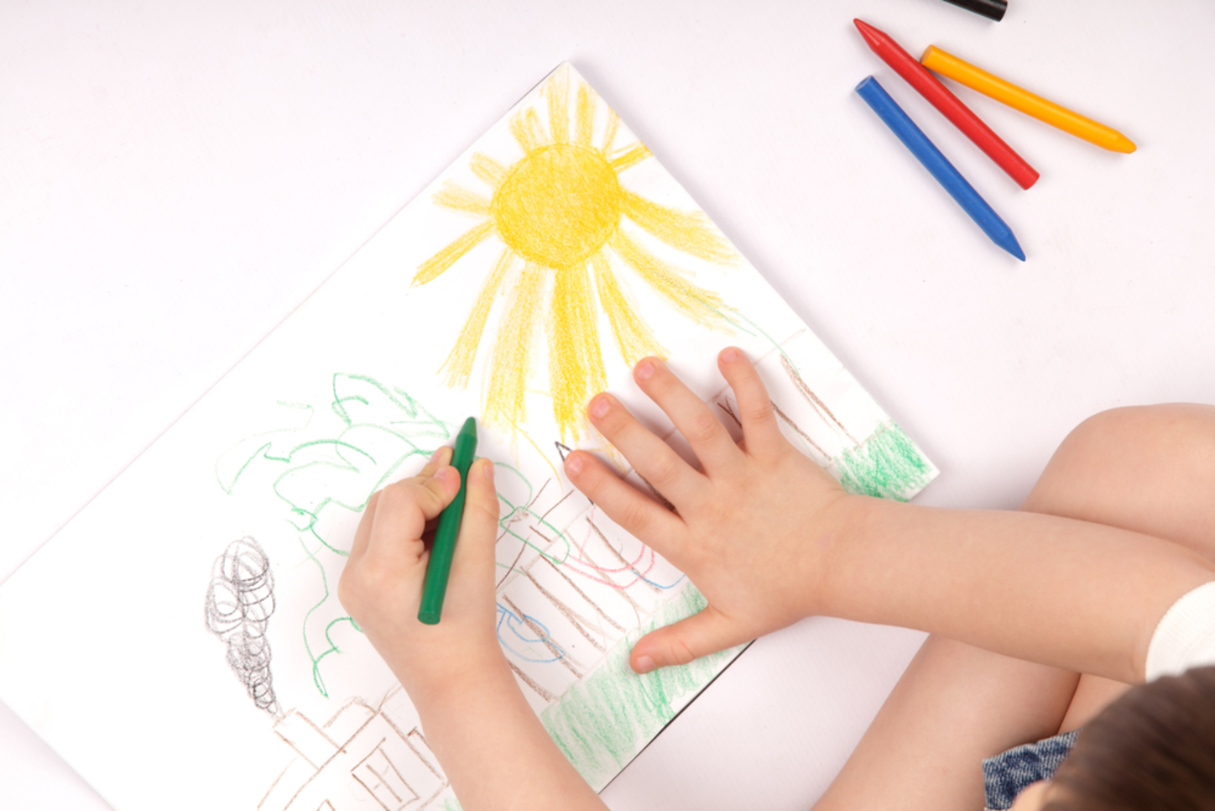
Fine motor development
Once your child has gained more control over their wrist movements, their fine motor control development will take place.
Again, all children will go through the following stages of pencil control, but at their own pace.
Children will go through the following stages of pencil grip before finally settling on the tripod grip in their preferred hand.

Slide 8
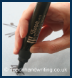
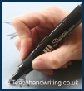
Stages of pencil grip
Palmer grip- the whole hand is used to grip the pencil
Reverse palmer- the whole hand is used with the pen nearest the paper
Four finger grip – using the tips of the fingers and thumb to hold the pen
Tripod grip – the pen is held between the thumb and first two fingers of the preferred/dominant hand
Remember some children do not develop the ability to use the tripod grip until the age of 5/6 years old

Slide 9
How to improve fine motor skills
In order for a child to be able to form the tripod grip successfully we recommend the following activities be used to strengthen their fingers and muscles in their hands:
Picking up rice and small beads using the pincer grip.
Opening clothes pegs to put on the line/box using the pincer grip.
Using and manipulating play dough e.g. rolling playdough in to a ball and then pulling sections carefully to make spikes.
Holding a small piece of chalk to draw with.
Colouring with short (no more than 1 inch/2.5cm) wax crayons, this naturally encourages the tripod grip without the children even realising
It is important that they have the correct tripod grip before learning to write the letters of the alphabet.

Slide 10
Pre writing skills
Before your child is taught to do formal handwriting they will have been given handwriting patterns to practice.
These patterns are taught in the same order as the letters in order to aid fluency when writing.
The order is as follows: long ladder letters (l i u t y j)
curly caterpillar letters (c a d g q o e s f)
one armed robot letters (r n m h b k p)
zig zag monster letters (z x v w)
Once your child is fluent with these patterns and they have perfected the tripod grip with refined wrist/hand movement, then we will introduce them to the cursive handwriting style used throughout the school.

Slide 11
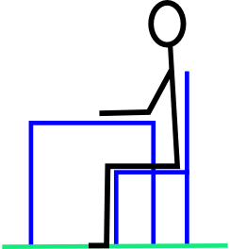
Correct sitting position
In order for a child to be able to write legibly, we recommend the following:
Tummy away from the table
Back leaning slightly forward
Chair well under the table
Bottom well back into the chair
Feet flat on the floor
Thighs fully supported and knees bent at 90 degrees
Bent elbow 5 cm above table

Slide 12
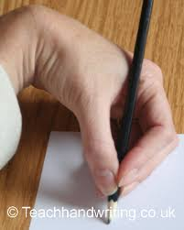
Correct paper position
Left Handed Paper position is key for left handed children as they will tend to hook their hand if the paper isn’t angled correctly. | Right Handed

Slide 13
Cursive handwriting
We use a style called “continuous cursive” for handwriting at school.
At the start the children are taught how to write individual letters.
They are taught to join the letters together in Year 1 when:
A: They have learnt to form letters correctly
B: Letters are of a consistent and suitable size
C: Letters are positioned appropriately on the writing line as well as in relation to one another.
Using the cursive style has been proven to increase the fluency of writing and also aid spelling.

Slide 14
www.teachhandwriting.co.uk
We recommend that you refer to this website for information on handwriting development, handwriting patterns and how to form letters correctly.
Thank you for listening , any questions?

