Slide 1
Transition to Nursery
Our Lady of Peace primary And Nursery School

Slide 2
Welcome
Dear Parents, Carers and children,
A huge welcome to Our Lady of Peace Nursery Class!
Some children and their families will be familiar with the school after siblings attending Nursery, some parents and carers will have attended the school as a child, and some of you will be completely new to us.
This presentation is full of information that will benefit everyone. You will have already received a transition booklet which is full of photographs and information for you to share with your child/children, and we hope that alongside this presentation, it gives you a good idea of what to expect in September.
We have been going through some unprecedented times but please be reassured that we have planned the start of the new school year to meet the emotional as well as academic needs of the children. We look forward to meeting you all in September.
We wish you a happy and safe summer.
Kind regards
Miss Drahota

Slide 3
Transition Days
Please check your letter from our admissions office regarding your child’s transition day.
We will be welcoming small groups of children to attend on one of the three dates below:
Wednesday 2nd September
Thursday 3rd September
Friday 4th September
The timings of the day will be:
08.45am – 10.45am or 12.15pm – 2.15pm depending on which day you will be attending.
YOUR CHILD ONLY ATTENDS ONE OF THESE DAYS AS STATED IN YOUR LETTER.
All morning only children start full time on Monday 7th September – 08.45am to 11.45am
All afternoon only children start full time on Monday 7th September – 12.15pm to 3.15pm
Full time children will be allocated a specific start date during the week beginning 7th September. Please check your letter stating your child’s start date. They will be attending school from 8.45am to 2.45pm or 3.15pm depending on your agreed finishing time.

Slide 4
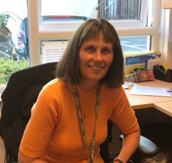
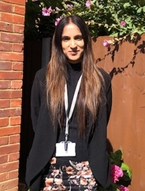
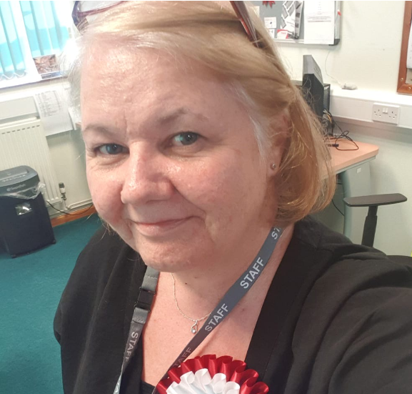
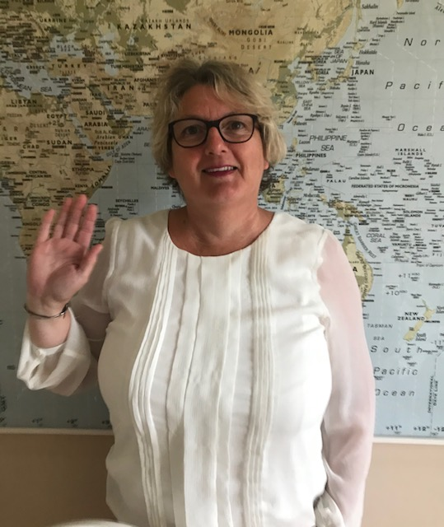
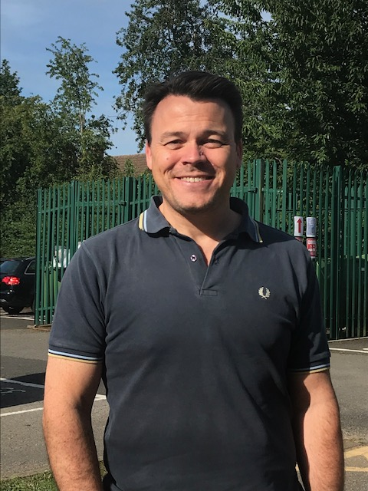
Meet the Senior Leadership Team
Mrs Holden
Head Teacher
Mrs Sidhu
Acting Deputy Head Teacher
Mrs Shoard
School Business Manager
Mr Head
Assistant Head Teacher
Mrs Clark
Assistant Head Teacher of Early Years

Slide 5
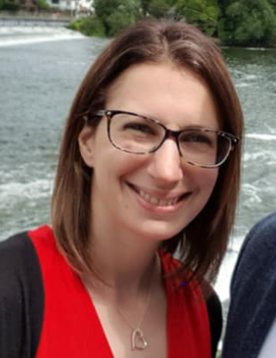
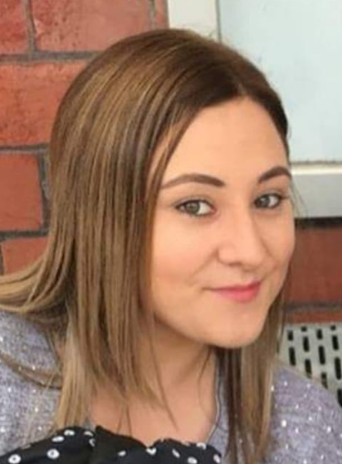
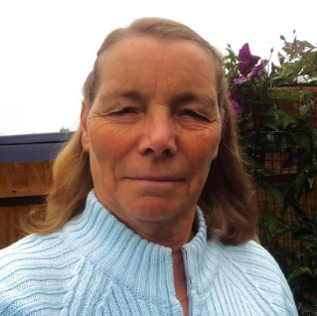
Meet the Teachers – St Nicholas Class
My name is Mrs Butler and I am the teaching assistant in St Nicholas Class. Welcome to our school.
My name is Mrs Featherstone and I am the teaching assistant in Nursery in the afternoons. I am looking forward to getting to know you!
My name is Miss Drahota and I am the Nursery Teacher. I can’t wait to meet you all!
My name is Miss McClean and I am the teaching assistant in St Nicholas Class. Welcome to our class.

Slide 6
The Early Years Foundation Stage
In Nursery your child will be learning through independent and collaborative play and exploration, adults playing alongside your child and direct teaching time, when children are asked to sit and listen to the class teacher and support staff in small groups. Each term a new timetable will be put on the school website so that you can see what we are learning, when.
As the year progresses the expectations of the children grow with them. They will be expected to undertake more adult directed tasks with and without supervision.
It is expected that children work towards their Early Learning Goals in Nursery as they are expected to achieve the goals by the end of their Reception year. As we know, all children learn at different speeds and meet their milestones at slightly different ages.
You will be informed of your child’s progress at parent’s Evenings which are held in the Autumn and Spring Terms.

Slide 7
EYFS Curriculum

Slide 8
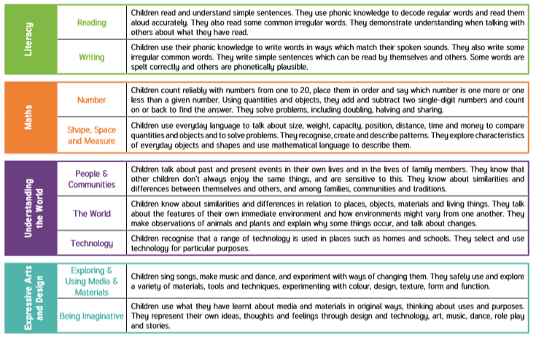

Slide 9
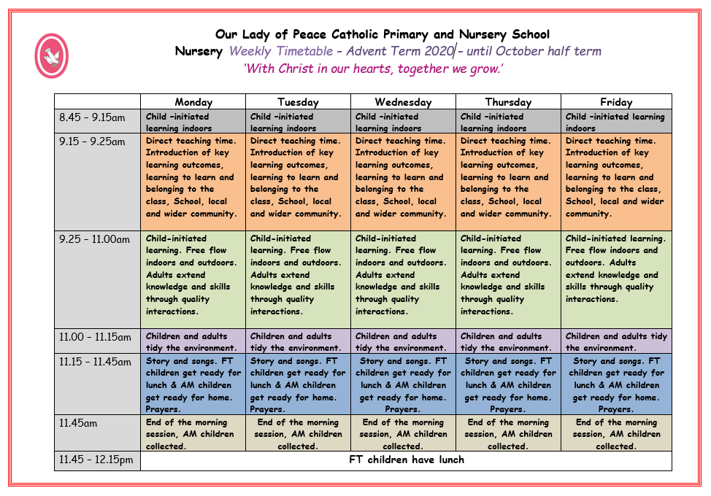
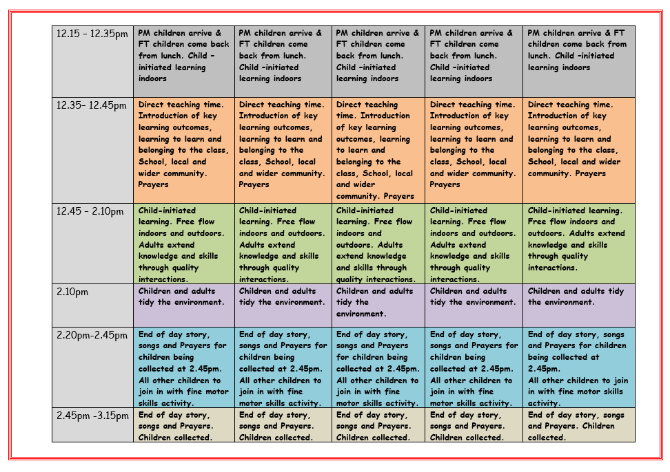
What does the day look like in Nursery?

Slide 10
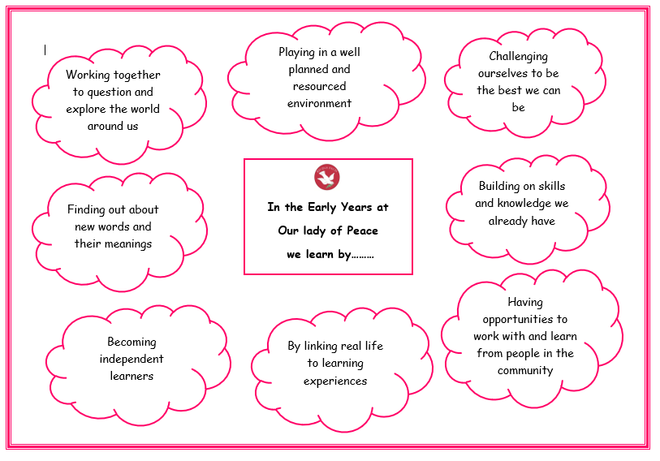
How we learn

Slide 11
Learning through play
“Play is not only crucial to the way children become self-aware and the way in which they learn the rules of social behaviour, it is also fundamental to intellectual development.”
Framework for Children’s Learning

Slide 12
Encouraging children to be curious about the world around them
Curiosity …leads to… Exploration
Exploration ...leads to… Discovery
Discovery …leads to… Pleasure
Pleasure …leads to… Repetition
Repetition …leads to… Mastery
Mastery …leads to… New Skills
New Skills …lead to… Confidence
Confidence …leads to… Self esteem
Self Esteem …leads to… Sense of Security
Sense of Security …leads to… More Exploration

Slide 13
Helping your child to get ready for Nursery
Share the transition document and this presentation with your child.
Please email a clear photograph of your child to the email address below so we are able to use it for their peg label in the cloak room ready for when they start.
Email address: nursery@olopprimary.co.uk
Do the journey to school with your child in the summer holidays
Share books with your child every day and sing lots of songs and rhymes.
Help them to become independent. Teach them how to dress and undress themselves, go to the toilet and eat their food with a knife and fork.
Get your child to bring in some photographs of their family, pets or a favourite holiday when they start Nursery. These photographs will go in their learning journals at school which they can look at whenever they like. These familiar pictures can help them settle into nursery and encourage them to talk about their home life.
Once your child is in Nursery, you will be sent a copy of the Nursery Weekly Plan. This will show you what we are learning in the coming week and has suggestions of how you can support your child at home. It is very important that you share this with your child so that they know what to expect and it gives you an opportunity to talk to your child about their learning.

