Slide 1
May 2016
With Christ in our hearts, together we grow

Slide 2
https://www.youtube.com/watch?v=ipm6nZ9OyLg&safe=active

Slide 3
Welcome to our ‘Values’ assembly
A value is a principle that guides behaviour
Week 1

Slide 4
Values that have been discussed so far:
Peace
Courage
Hope
Equality
Compassion
Love
Trust
Respect

Slide 5
In May we will be exploring:
Self-Belief

Slide 6
Self Belief

Slide 7
How can you increase your Self- belief?
Try your very best at everything you do!
Don’t let yourself give up when things go wrong!
Realise that hard work and effort lead to the rewards you want – and not what other people want

Slide 8
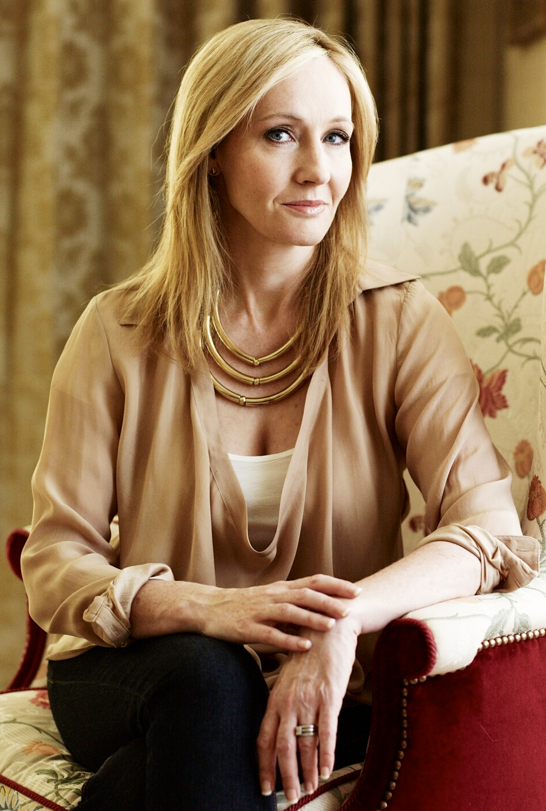
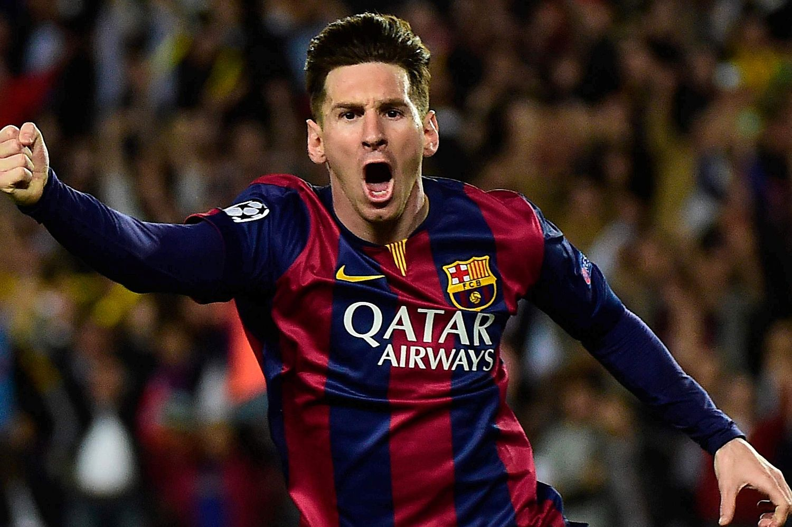
These people have all achieved their goals …but they have WORKED HARD FOR THEM!

